Slide 1


Project Report 2
Ava Powers

Slide 2
What is in the Data File?
Columns in the Data File:
"user_id","name","review_count" ,"average_stars","cool_votes", "funny_votes","useful_votes" ,"friends", "elite", "yelping_since","fans"
552,339 entries
All columns of data contain numeric data except for the columns user_id, name, and friends, which are strings.
Notes:
The data frame we used was called the user data set, which contained data regarding different businesses on Yelp

Slide 3
Summary of Data Analysis
Step 1: Loaded the Data File
Step 2: Performed a Pearson's Correlation, 0.98 (cool&useful) & 0.97(cool&funny), significant correlation
Step 3: Performed linear regression of cool and funny votes, very significant (r=1.09)
Step 4: Performed Linear Regression of review_count and fans, does not necessarily predict more fans (r=0.07)
Step 5: Found another variable through linear regression that predicts more fans, average_stars, r=0.09.
Step 6: Used k-means to organize into clusters, inconclusive clusters

Slide 4
What can a Yelp user do to enhance popularity/impact on their platform?
Popularity/Impact = fans/review_count respectively
The correlation scores are significant with both review_count and fans crossed with funny_votes, useful_votes, and cool votes (all have r=>.5).
Fans should be encouraged to review the business on Yelp by the business itself
Give specific reviews rather than just stars; stars do not have a high correlation with review_count/fans.

Slide 5
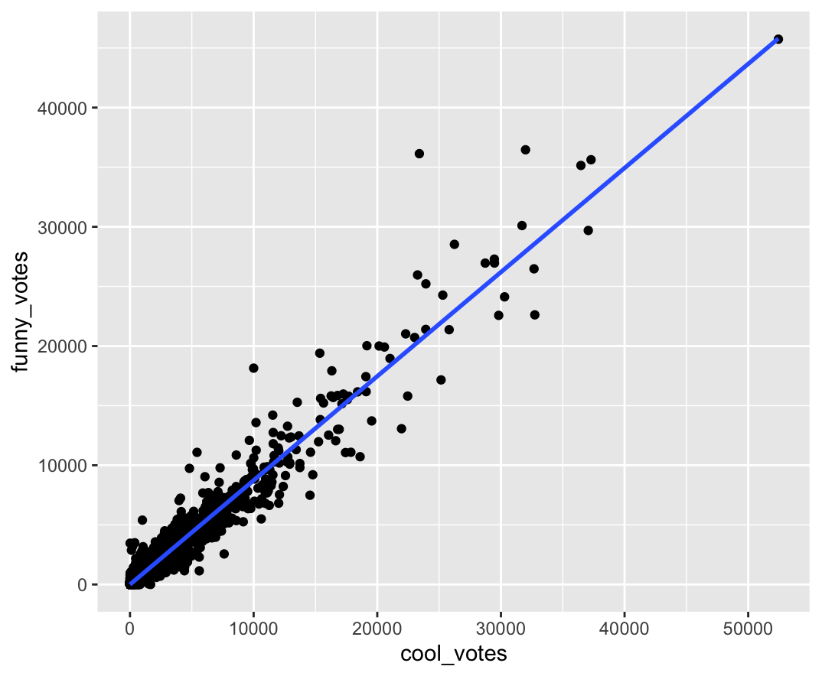
Graphs and Tables
Step 3 Graph

Slide 6
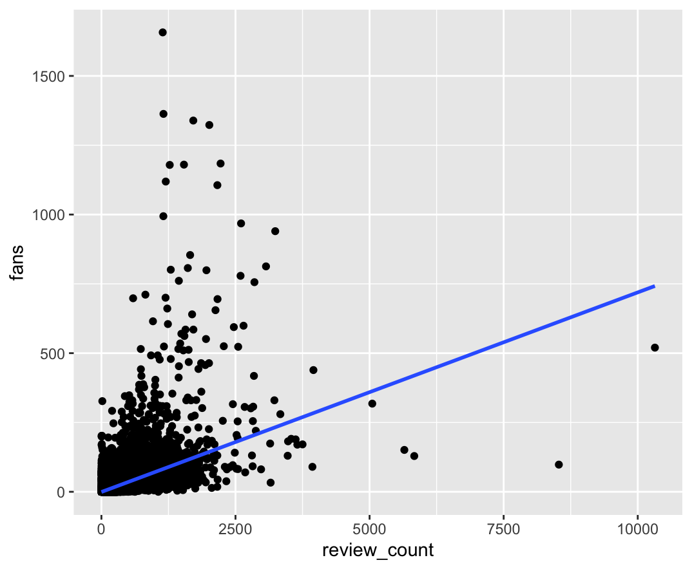
Graphs and Tables
Step 4 Graph

Slide 7
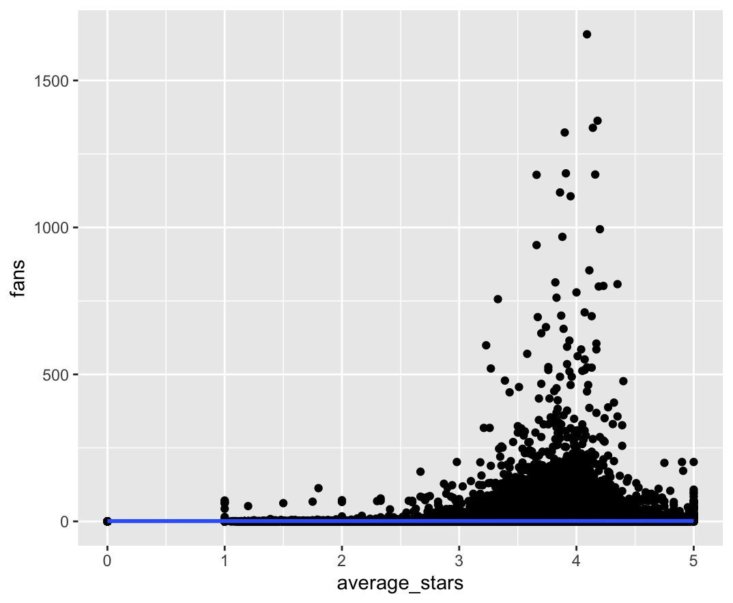
Graphs and Tables
Step 5 Graph

Slide 8
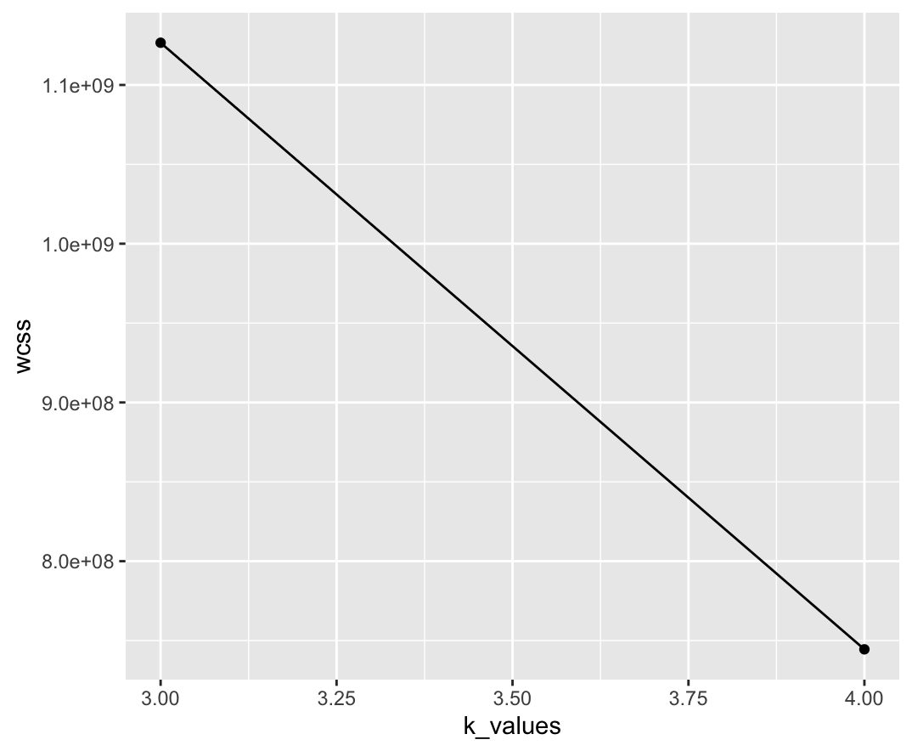
Graphs and Tables
Step 6 graph

